Slide 1
3. HTML
ICT-Training Technical Skills

Slide 2
Introduction to HTML
HTML stands for Hyper Text Markup Language.
HTML is the standard markup language for creating Web pages.
HTML describes the structure of a Web page.
HTML consists of a series of elements.
HTML elements tell the browser how to display the content.
HTML elements label pieces of content such as "this is a heading", "this is a paragraph", "this is a link", etc.

Slide 3
Features of HTML
It is a very easy and simple language. It can be easily understood and modified.
It is very easy to make an effective presentation with HTML because it has a lot of formatting tags.
It is a markup language, so it provides a flexible way to design web pages along with the text.
It facilitates programmers to add a link on the web pages (by html anchor tag), so it enhances the interest of browsing of the user.
It is platform-independent because it can be displayed on any platform like Windows, Linux, and Macintosh, etc.
It facilitates the programmer to add Graphics, Videos, and Sound to the web pages which makes it more attractive and interactive.
HTML is a case-insensitive language, which means we can use tags either in lower-case or upper-case.

Slide 4
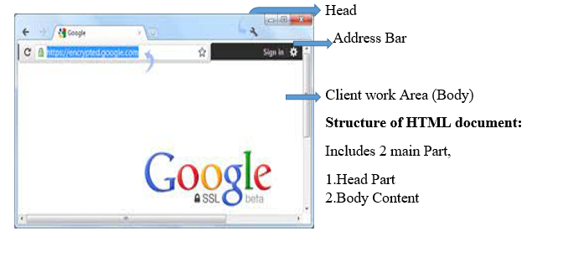
Structure of HTML

Slide 5
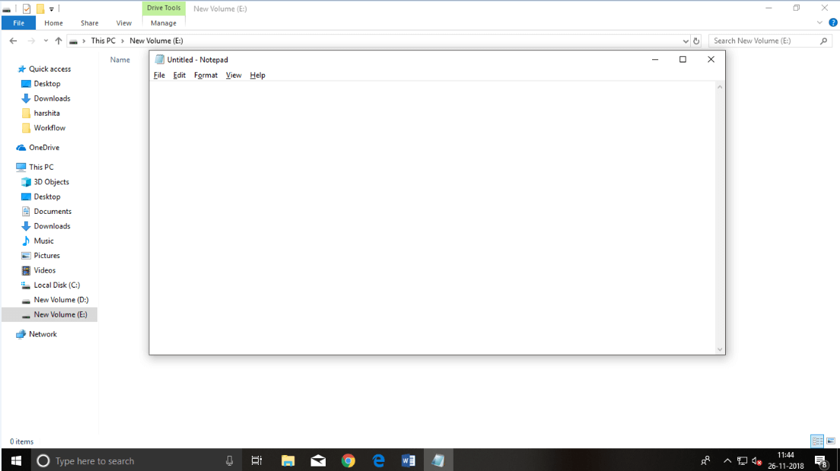
HTML Text Editors
Text editors are the programs which allow editing in a written text, hence to create a web page we need to write our code in some text editor.
professional text editors are Notepad++, Sublime Text, Vim, etc.
Notepad is a simple text editor and suitable for beginners to learn HTML.

Slide 6
Building blocks of HTML
Tags: An HTML tag surrounds the content and apply meaning to it. It is written between < and > brackets.
Attribute: An attribute in HTML provides extra information about the element, and it is applied within the start tag. An HTML attribute contains two fields: name & value.
Elements: An HTML element is an individual component of an HTML file. In an HTML file, everything written within tags are termed as HTML elements.
Syntax
<tag name attribute_name= " attr_value"> content </ tag name>

Slide 7
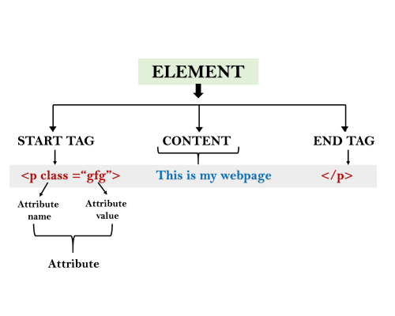
Building blocks of HTML

Slide 8
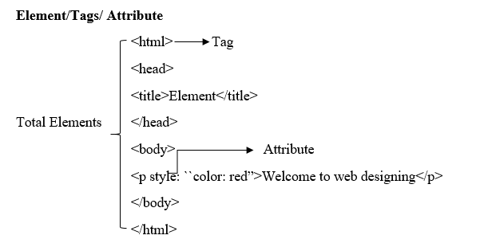
HTML elements/Tags/Attribute

Slide 9
HTML Tags
All HTML tags must enclosed within < > these brackets.
Every tag in HTML perform different tasks.
If you have used an open tag <tag>, then you must use a close tag </tag> (except some tags)
Syntax
<tag> content </tag>

Slide 10
HTML Attribute
HTML attributes are special words which provide additional information about the elements or attributes are the modifier of the HTML element.
Each element or tag can have attributes, which defines the behaviour of that element.
Attributes should always be applied with start tag.
The Attribute should always be applied with its name and value pair.
Syntax
<element attribute_name="value">content</element>

Slide 11
HTML Elements
Element is a collection of start tag, attributes, end tag, content between them.
Eg:
<p> Hello world!!! </p>

Slide 12
HTML Tags and Elements
HTML tags are used to hold the HTML element.
HTML element holds the content.
HTML attributes are used to describe the characteristic of an HTML element in detail.
HTML tag starts with < and ends with > Whatever written within a HTML tag are HTML elements.

Slide 13
Block-level and Inline HTML elements
A block-level element always start with new line and takes the full width of web page, from left to right.
Elements are
<address>, <article>, <aside>, <blockquote>, <canvas>, <dd>, <div>, <dl>, <dt>, <fieldset>, <figcaption>, <figure>, <footer>, <form>, <h1>-<h6>, <header>, <hr>, <li>, <main>, <nav>, <noscript>, <ol>, <output>, <p>, <pre>, <section>, <table>, <tfoot>, <ul> and <video>

Slide 14
Inline element
These elements does not start with new line and take width as per requirement
Elements are
<a>, <abbr>, <acronym>, <b>, <bdo>, <big>, <br>, <button>, <cite>, <code>, <dfn>, <em>, <i>, <img>, <input>, <kbd>, <label>, <map>, <object>, <q>, <samp>, <script>, <select>, <small>, <span>, <strong>, <sub>, <sup>, <textarea>, <time>, <tt>, <var>.

Slide 15
HTML Formatting
Formatting Tags used are
<b>-This is a physical tag, which is used to bold the text written between it.
<strong> -This is a logical tag, which tells the browser that the text is important.
<i>-This is a physical tag which is used to make text italic.
<em>-This is a logical tag which is used to display content in italic.
<mark>-This tag is used to highlight text.
<u>-This tag is used to underline text written between it.
<tt>-This tag is used to appear a text in teletype. (not supported in HTML5)

Slide 16
HTML Formatting
<strike> -This tag is used to draw a strikethrough on a section of text. (Not supported in HTML5)
<sup>-It displays the content slightly above the normal line.
<sub>-It displays the content slightly below the normal line.
<del>-This tag is used to display the deleted content.
<ins>-This tag displays the content which is added
<big>-This tag is used to increase the font size by one conventional unit.
<small>-This tag is used to decrease the font size by one unit from base font size.

Slide 17
HTML Heading
A HTML heading or HTML h tag can be defined as a title or a subtitle which you want to display on the webpage.
It is also called friends tag using HTML.
Example:
<h1>Heading no. 1</h1>
<h2>Heading no. 2</h2>
<h3>Heading no. 3</h3>
<h4>Heading no. 4</h4>
<h5>Heading no. 5</h5>
<h6>Heading no. 6</h6>

Slide 18
HTML Paragraph
HTML paragraph or HTML p tag is used to define a paragraph in a webpage.
Example:
<p>This is first paragraph.</p>
<p>This is second paragraph.</p>
<p>This is third paragraph.</p>

Slide 19
HTML Anchor
The HTML anchor tag defines a hyperlink that links one page to another page.
It can create hyperlink to other web page as well as files, location, or any URL.
Syntax of HTML anchor tag is given below.
<a href = "..........."> Link Text </a>
Example of HTML anchor tag.
<a href="second.html">Click for Second Page</a>

Slide 20
HTML Image
HTML img tag is used to display image on the web page.
HTML img tag is an empty tag that contains attributes only, closing tags are not used in HTML image element.
example of HTML image.
<h2>HTML Image Example</h2>
<img src="good_morning.jpg" alt="Good Morning Friends"/>
<img src="animal.png" height="180" width="300" alt="animal image">

Slide 21
HTML Table
HTML table tag is used to display data in tabular form (row * column). There can be many columns in a row.
We can create a table to display data in tabular form, using <table> element, with the help of <tr> , <td>, and <th> elements.
Table Example
<table>
<tr><th>First_Name</th><th>Last_Name</th><th>Marks</th></tr>
<tr><td>Sonoo</td><td>Jaiswal</td><td>60</td></tr>
<tr><td>James</td><td>William</td><td>80</td></tr>
<tr><td>Swati</td><td>Sironi</td><td>82</td></tr>
<tr><td>Chetna</td><td>Singh</td><td>72</td></tr>
</table>

Slide 22
HTML Table with rowspan
<table>
<tr><th>Name</th><td>Ajeet Maurya</td></tr>
<tr><th rowspan="2">Mobile No.</th><td>7503520801</td></tr>
<tr><td>9555879135</td></tr>
</table>

Slide 23
HTML Lists
There are three different types of HTML lists
Ordered List or Numbered List (ol)
Unordered List or Bulleted List (ul)
Description List or Definition List (dl)

Slide 24
HTML Ordered List or Numbered List
<ol>
<li>Aries</li>
<li>Bingo</li>
<li>Leo</li>
<li>Oracle</li>
</ol>

Slide 25
HTML Unordered List or Bulleted List
<ul>
<li>Aries</li>
<li>Bingo</li>
<li>Leo</li>
<li>Oracle</li>
</ul>

Slide 26
HTML Description List or Definition List
<dl>
<dt>Aries</dt>
<dd>-One of the 12 horoscope sign.</dd>
<dt>Bingo</dt>
<dd>-One of my evening snacks</dd>
<dt>Leo</dt>
<dd>-It is also an one of the 12 horoscope sign.</dd>
<dt>Oracle</dt>
<dd>-It is a multinational technology corporation.</dd>
</dl>

Slide 27
Example Code
Login1.html
<html>
<head>
<title>Form</Form>
</head>
<body>
<form>
<table>
<tr><td colspan="2"><h1>Registration Form</h1></td></tr>
<tr><td><b>First name:</b></td>

Slide 28
Continue Code…
<td><input type="text" id="fname" name="fname"></td></tr>
<tr><td><b>Last name:</b></td>
<td><input type="text" id="lname" name="lname"></td></tr>
<tr><td colspan="2"><center><input type="submit" value="submit"></center></td></tr>
</table>
</form>
</body>
</html>

